Slide 1

OVERVIEW OF TEST PLAN
Instructor: Dr. GalE
Presented by: Amir Hossein Torabi
Kody Davis
Khalil Blaine
Mac Jeffers

Slide 2

Outline
What is a test and why do we so testing?
What is a test plan?
What are different types of tests?
What is a datasheet and what are its parts?
Determine the test plan
Continuity test
Functional test
Measuring V_{IL} and V_{IH}
Measuring V_{OL} and V_{OH}
Refererences

Slide 3
Testing
A test can be considered an observation or experiment that determines one or more characteristics of a given sample, product, process, or service.
The results of testing can be qualitative (pass/fail) or quantitative (a measured value) and can be derived from personal observation or the output of a precision measuring instrument (ATEs).
Some test results are dependent variables, based on the particular conditions of the test or the level of the independent variable(s).
Some tests, however, may involve changing the independent variable to determine the level at which a certain response occurs: in this case, the test result is the independent variable.
Notes:
1. for example: functinal test of logic gates which are related to the input logic levels
2. for examle: Voh or Vol

Slide 4
Why testing?
Testing of chips is necessary because the chip manufacturing process cannot provide 100% yield and chips need to be screened. Therefore, every chip has to be tested before it is shipped out to the market.
We do testing to:
Measuring the properties or performance of products, to be sure that they meet the published specifications (datasheets)
Ensure the quality of the product (Quality means satisfying the user’s needs at a minimum cost)
Increase the overall quality of the system
Identify defects and reduce flaws in the components at earlier stage
Provide design feedback to increase yield and save cost
Notes:
Rule of 10
Co-working of design/product/test engineer teams
Reduce costs
Redesign and remake until best result.

Slide 5
Why testing?
“To err is human” While accepting imperfect products from others, we desire perfection in our products. But how?
Here is the formula: Perfect Testing Algorithm:
Repeat
{
Redesign;
Remake;
}
Until tested perfect
The repeat loop in our algorithm will repeat indefinitely unless redesign and remake could respond to or correct the errors found in testing

Slide 6
Test Plan
A test plan documents the strategy that will be used to verify and ensure that a product or system meets its design specifications and other requirements.
A test plan is usually prepared by test engineers.
A high-quality test does not happen by accident. Just as it takes careful planning and execution to create a new design, it also takes careful planning and execution to create and implement a test plan that will ensure the highest possible test coverage and product quality.
Design a precise Test Plan is an art which demands both deep knowledge and professional experience.
Notes:
Art of Test Plan

Slide 7
Test Plan
A test plan usually contains three parts: Test Coverage, Test Methods, and Test Responsibilities
Test Coverage: states what requirements will be verified during what stages of the IC operation. It is derived from design specifications and other requirements, such as safety standards or regulatory codes. It also feeds back into the design process.
Test Methods: state how test coverage will be implemented. They may be determined by standards, regulatory agencies, or contractual agreement. They also specify test equipment to be used in the tests and establish pass/fail criteria
Notes:
Art of Test Plan

Slide 8
Test Plan
Valid test methods often encompass the following considerations:
accuracy and precision; repeatability and reproducibility, sometimes in the form of a Gauge R&R; range, or scale over which the test method would be considered; measurement resolution; measurement uncertainty
Test Responsibilities: include which persons or what organizations will perform the test methods and in what sequence. This allows us to plan, acquire or develop test equipment and other resources necessary to implement the test methods for which they are responsible.
Notes:
Art of Test Plan

Slide 9
Test Types
A test plan usually defines the types of tests which should be done on the specific IC and includes a strategy for that:
Design Verification or Compliance test (Characterization step)
Manufacturing or Production test (Production step)
Acceptance or Commissioning test (Inspection step)
What we want to do in this project is acceptance or commissioning tests. To perform that, we need to know the specification, feature, characteristics and other related information about a DUT. Thus, to have a test plan we need to understand the datasheet of the DUT.
Notes:
1– to be performed during the development or approval stages of the product, typically on a small sample of units
2– to be performed during preparation or assembly of the product in an ongoing manner for purposes of performance verification and quality control. It is done for all
3– to be performed at the time of delivery or installation of the product usually by the customer

Slide 10
Datasheet
What is a datasheet?
Datasheets contain information available from the IC manufacturer with the purpose of assisting component and system-design engineers in selecting its products.
Information includes a brief description of terms, definitions, and testing procedures currently used for different types of specifications.
Symbols, terms, and definitions generally are in accordance with those currently agreed upon by the JEDEC Solid State Technology Association for use in the USA and by the International Electrotechnical Commission (IEC) for international use.
Notes:
Types of specification: military, commercial, industrial, medical, aerospace, ….

Slide 11
Datasheet
What are parts of a datasheet?
Features, Applications, Description, Symbol(s) and Graphic(s) and Marking
Specifications (usually concise and tabular form)
Pin Configuration and Functions
Absolute Maximum Ratings
ESD Ratings
Recommended Operating Conditions
Thermal Information
Electrical Characteristics
Timing Requirements
Switching Characteristics
Typical Characteristics
Notes:
From device to device or manufacturer to manufacturer, a datasheet may differ. But this information is almost available in all datasheets, especially Logic Ics.

Slide 12
Datasheet
Parameter Measurement Information
Detailed Description
Functional Block Diagram
Feature Description
Device Functional Modes
Application, Implementation and Application Information
Typical Application
Design Requirements
Detailed Design Procedure
Application Curves
Power Supply Recommendations

Slide 13
Datasheet
Layout
Layout Guidelines
Layout Example
Device and Documentation Support and Revision History of the Document
Mechanical and Packaging Information
Ordering Information
By carefully reading the datasheet, we can design or select appropriate Functional and Parametric tests.
Notes:
Parametric tests: AC, DC, Timing and Switching tests. They are technology dependent. From CMOS to TTL they may change.
Functional tests: check the proper operation of the ICs. For example, by applying vectors to the inputs and monitoring the outputs. They have to cover a very high percentage of modeled (e.g., stuck type) faults

Slide 14
Datasheet
Absolute Maximum Rating:
specifies the stress levels that, if exceeded even for a moment, may cause permanent damage to the device.
When a device is used in excess of any absolute maximum rating, it may not recover, and in many cases, permanent damage will occur.
Some of ratings may be exceeded under certain conditions which presented in the datasheet. For example, the input and output voltage ratings (V_{I} and V_{O}) of CMOS logic gates may be exceeded if the input and output maximum clamp current ratings, I_{IK} and I_{OK}, are observed.
Notes:
During the tests, AMR should be considered to prevent any damage to the device.

Slide 15
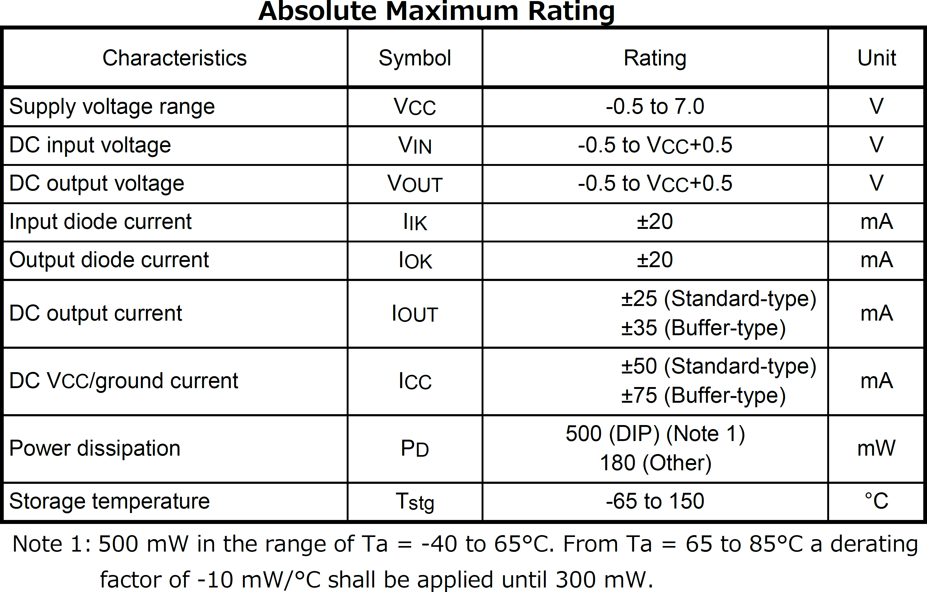
Datasheet
Notes:
General absolute maximum ratings for HC/HCT CMOS logic ICs
In addition to the AMR, we have ESD ratings. ESD has two types: air discharge and contact discharge. AD may cause more sever defect to ICs. They are tested under known conditions in labs. If an IC tend to be used in medical or industrial applications, it has higher voltage criteria than for example ordinary and commercial ICs.
One example is cars. They must resist against high ESD. Because of contact between air and body of the car, ESD produces and there is not any conducting way to the earth because tires are good insulators. In especial cases, the body of the tankers which carry gasoline or other flammable liquids or gases, should be grounded before draining the tanks to prevent produce of even tiny spark as a result of ESD.
Aerospace applications even have their own ESD ratings. For example, because of the contact between the body of rockets and air during lunch. And when a satellite is outside of atmosphere, there will be no way to discharge this electrostatic charge to any other low voltage potentials, like what we do by grounding our body before touching the sensitive electronic devices.

Slide 16
Datasheet
Recommended Operating Conditions:
They sets the conditions for device operation.
These are the conditions under which the operation of ICs is guaranteed. When any of these values is exceeded, operation is not guaranteed, even if the value is still within the absolute maximum ratings.
Unused input terminals must be connected to either VCC or GND.
The limits for items that appear in this section are used as test conditions for the limits that appear in the Electrical Characteristics, Timing Requirements, Switching Characteristics, and Operating Conditions sections of the datasheet.
Notes:
The limits in this part of the datasheet will be used as our test conditions

Slide 17
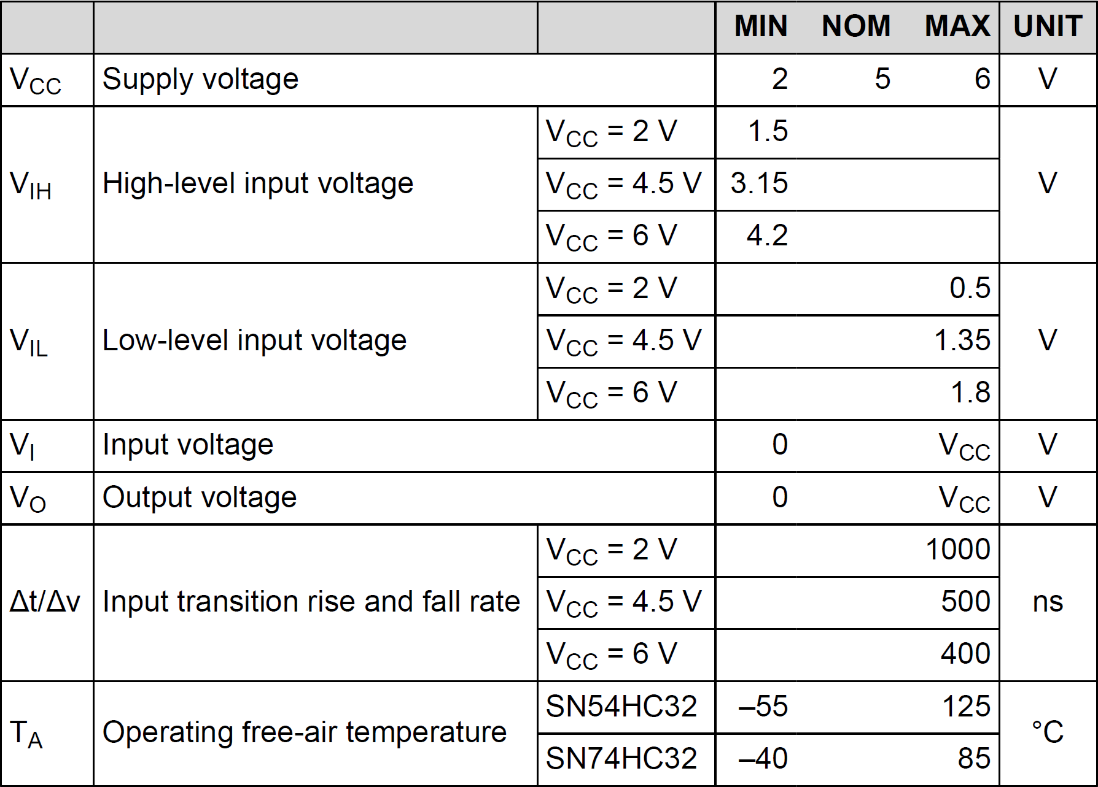
Datasheet
Notes:
Our SN74HC32 recommended operating conditions

Slide 18
Datasheet
Electrical Characteristics (or DC Characteristics)
It provide the specified electrical characteristic limits of the device when tested under the conditions in the Recommended Operating Conditions, as given specifically for each parameter.
Typical parameters of Electrical Characteristics are:
Input voltages: V_{IH}, V_{IL}, V_{P}, V_{N}
Output Voltages: V_{OH}, V_{OL}
Leakage currents: I_{OFF}, I_{OZ}, I_{IN}, I_{OPD}, I_{I/O}, I_{CC}, ΔI_{CC}
→ Some of these parameter will be covered in the testing project.

Slide 19
Datasheet
Switching Characteristics (or AC Characteristics):
This section addresses how fast the outputs will respond to signal changes at the inputs under specified conditions of supply voltage, temperature, and load.
Typical parameters of Switching Characteristics are:
f_{max}, t_{PLH}, t_{PHL}, t_{PZL}, t_{PLZ}, t_{PHZ}
→ None of these parameter will be covered in the testing project.
Notes:
Switching defines the relationship between inputs and outputs

Slide 20
Datasheet
Timing Requirements:
This section addresses the timing relationships between transitions of one or more input signals that are necessary to ensure device functionality and applies only to sequential-logic devices.
Typical parameters of Switching Characteristics are:
t_{w(H)}, t_{w(L)}, t_{s}, t_{h}, t_{rem}, t_{rr}, t_{TLH} , t_{THL}
→ None of these parameter will be covered in the testing project (they are related to sequential-logic ICs).
Notes:
Timing defines the relationship between inputs

Slide 21
Datasheet
Other useful sections of a datasheet:
Information about parameter measurements: illustrates the test loads and waveforms that are used when testing the device.
Packaging information: is used by PCB designers to select the appropriate footprint of ICs and consider other requirements of locating the IC on the board (for example: space needed for heatsinks)

Slide 22
Prepare Test Plan
To prepare and document test plan we need to:
Specify the DUT and obtain its datasheet
Specify the measurement equipment and obtain its datasheet
Select those characteristics of the DUT that can be tested by the measurement equipment considering its limitations
Specify the required circuit for testing the parameters
Validate the measurement equipment and determine its systematic error to find the (first-order) calibration equation

Slide 23
Prepare Test Plan
Be sure that the DUT and the measurement equipment work well (Continuity and Functionality tests)
Do the tests on the DUT multiple times (repeatability)
Validate the results and compare them with the data given in datasheet
Report the final results

Slide 24
Test Plan
An “HCMOS quad 2-input OR Gates”, 74HC32, is used as the DUT. It is made by TI. (Datasheet)
NI MyDaq is the measurement unit. (Datasheet)
Following parameters of 74HC32 can be measured with Mydaq: V_{IH}, V_{IL}, V_{OH}, V_{OL}, V_{clamp}, I_{OH}, I_{OL}
Timing, switching and thermal parameters cannot be tested.
The conditions under which each test is going to be performed will be depicted in the following slides.
5, 6, 7, 8, 9. The results will be shown in the following slides.

Slide 25
Continuity Test
Continuity test is the simplest test for making sure that DUT is not dead (i.e. all electrical connections are good)
Continuity testing is usually performed by detecting the presence of on-chip protection circuits.
These circuits protect each input and output of the device from electrostatic discharge (ESD) and other excessive voltage conditions.
SN74HC32 has 12 I/O pins, all of which has two clamping diodes. Thus, we need to perform continuity tests 12 times.

Slide 26
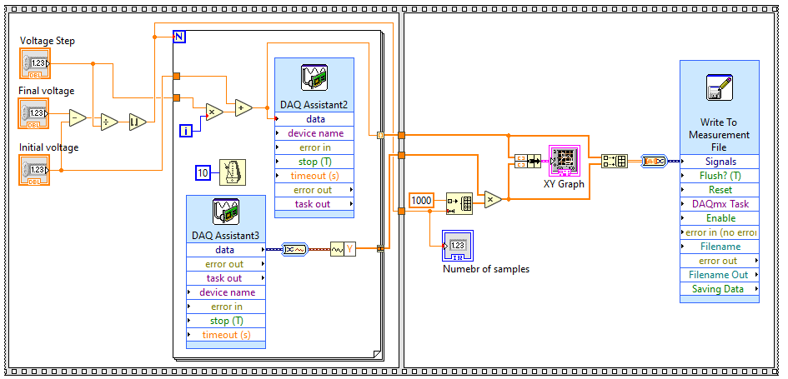
Continuity Test

Slide 27
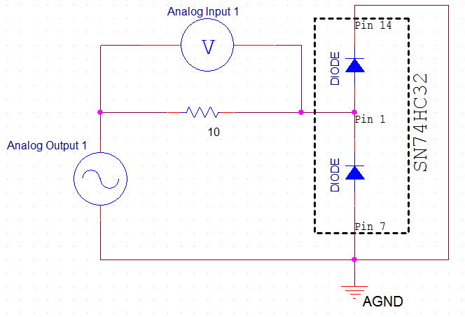
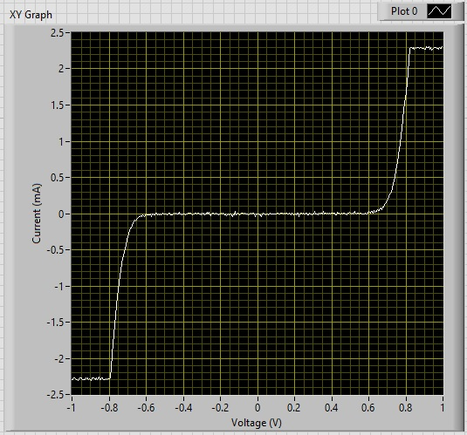
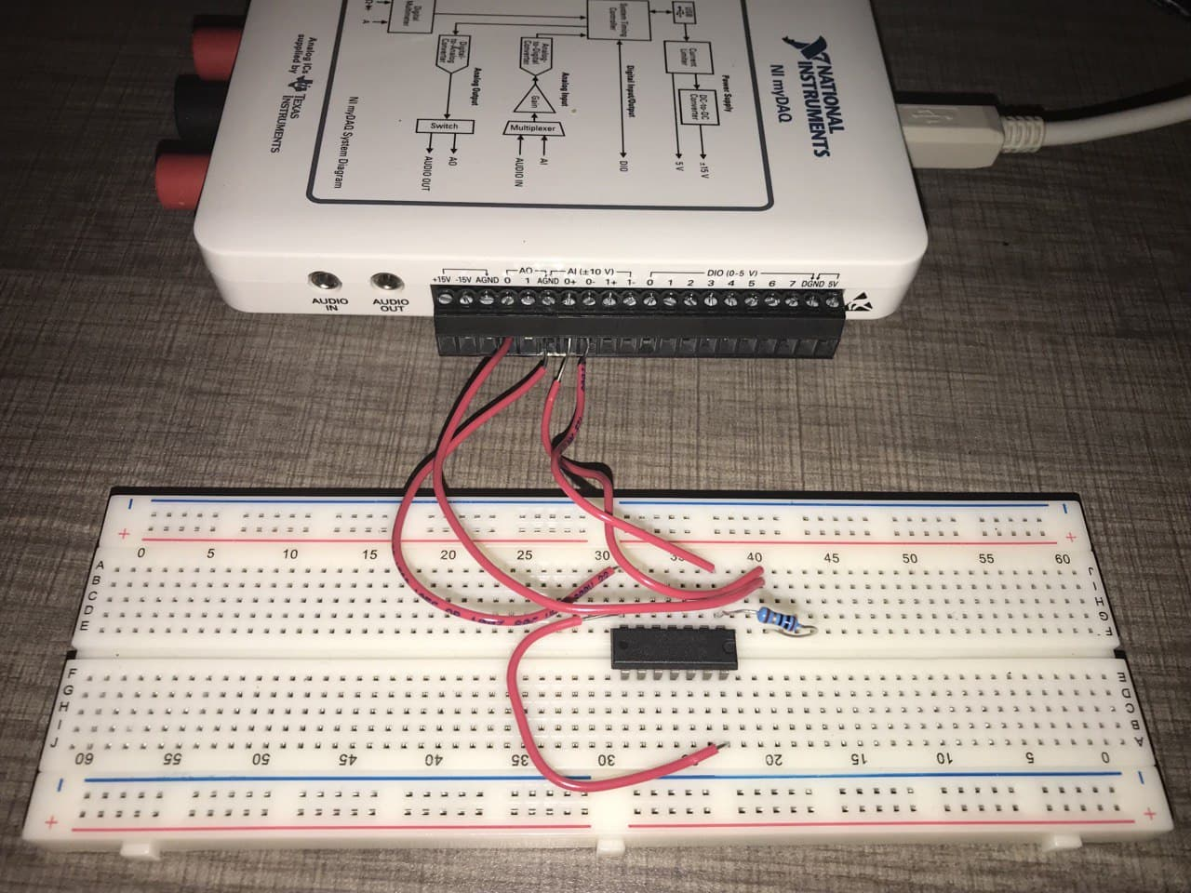
Continuity Test

Slide 28
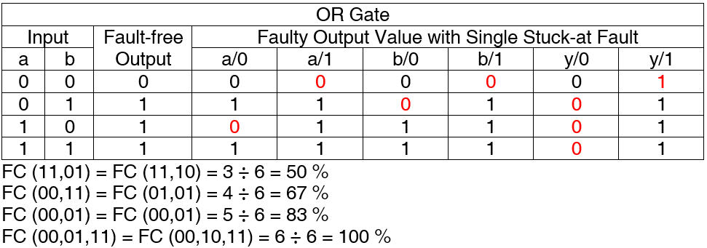
Functional Test
To have a 100% stuck-at faults coverage for an OR gate, we need to apply three vectors to the inputs.
Therefore, “00”, “01” and “11” will be applied to each inputs by using digital outputs of MyDaq and the result is monitored by connecting the output of the gate to digital input of MyDaq.

Slide 29
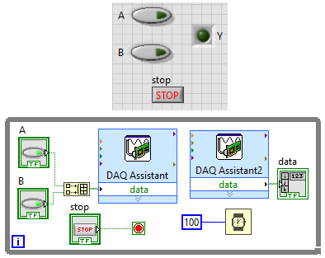
Functional Test
Following LabView code is used to test the functionality of the IC. All gates were tested. The device passed the functionality test.

Slide 30
V_{IH} and V_{IL}
V_{IH} (V_{IL}) represents “High-Level Input Voltage” (“Low-Level Input Voltage”) of a logic gate. V_{IH(min)} (V_{IL(max)}) is specified that is the least (most) positive value of high-level (low-level) input voltage for which operation of the logic element within specification limits is to be expected.
Both V_{IH(min)} and V_{IL(max)} are required to set up V_{OH} and V_{OL}.
CMOS inputs have input levels scaled with respect to V_{CC} (for each V_{CC} voltage, V_{IH(min)} and V_{IL(max)} may change)

Slide 31
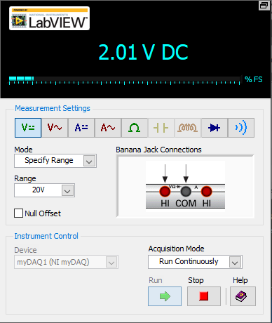
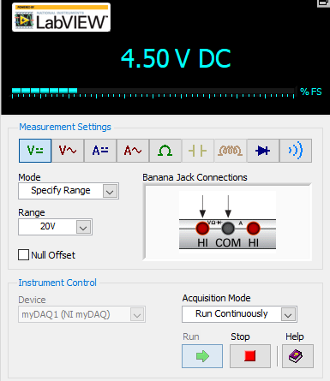
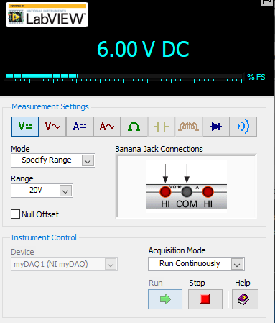
V_{IH} and V_{IL}
In datasheet, the V_{IH} and V_{IL} values are reported for three VCC voltages: 2, 4.5 and 6 V.
To be able to measure at these VCC voltages and compare the results, a variable voltage source is made by using LM317 voltage regulator and appropriate resistors and a potentiometer.

Slide 32
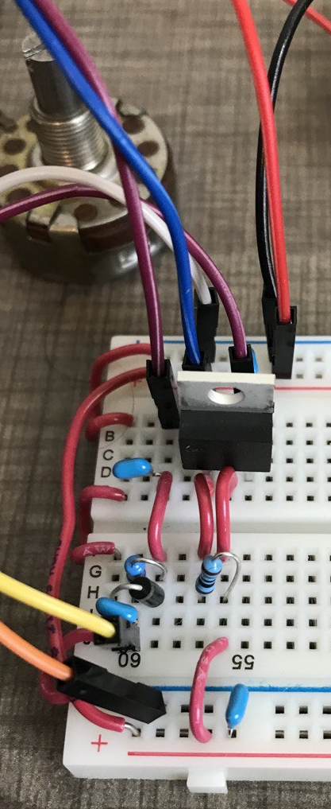
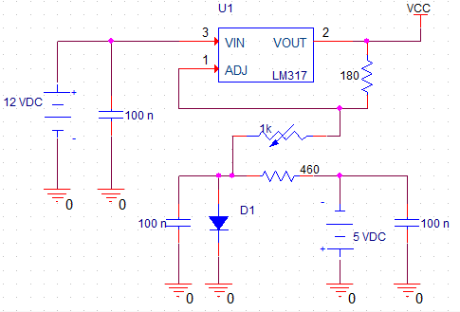
V_{IH} and V_{IL}

Slide 33
V_{IH} and V_{IL}
How to measure V_{IH(min)}?
One input (A) is connected to the analog output of MyDaq.
All other inputs of the IC are grounded.
Ramp voltage in applied to the connected input.
The output of the gate is monitored to find at which voltage transition to V_{CC} happens (or change from “0” to “1” logic).

Slide 34
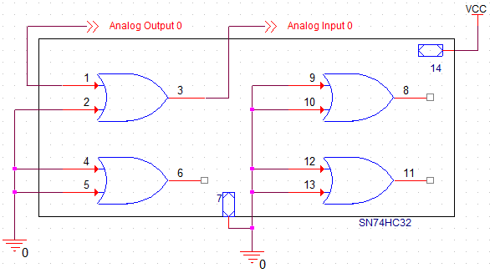
V_{IH} and V_{IL}
Circuit for testing V_{IH} and V_{IL}

Slide 35
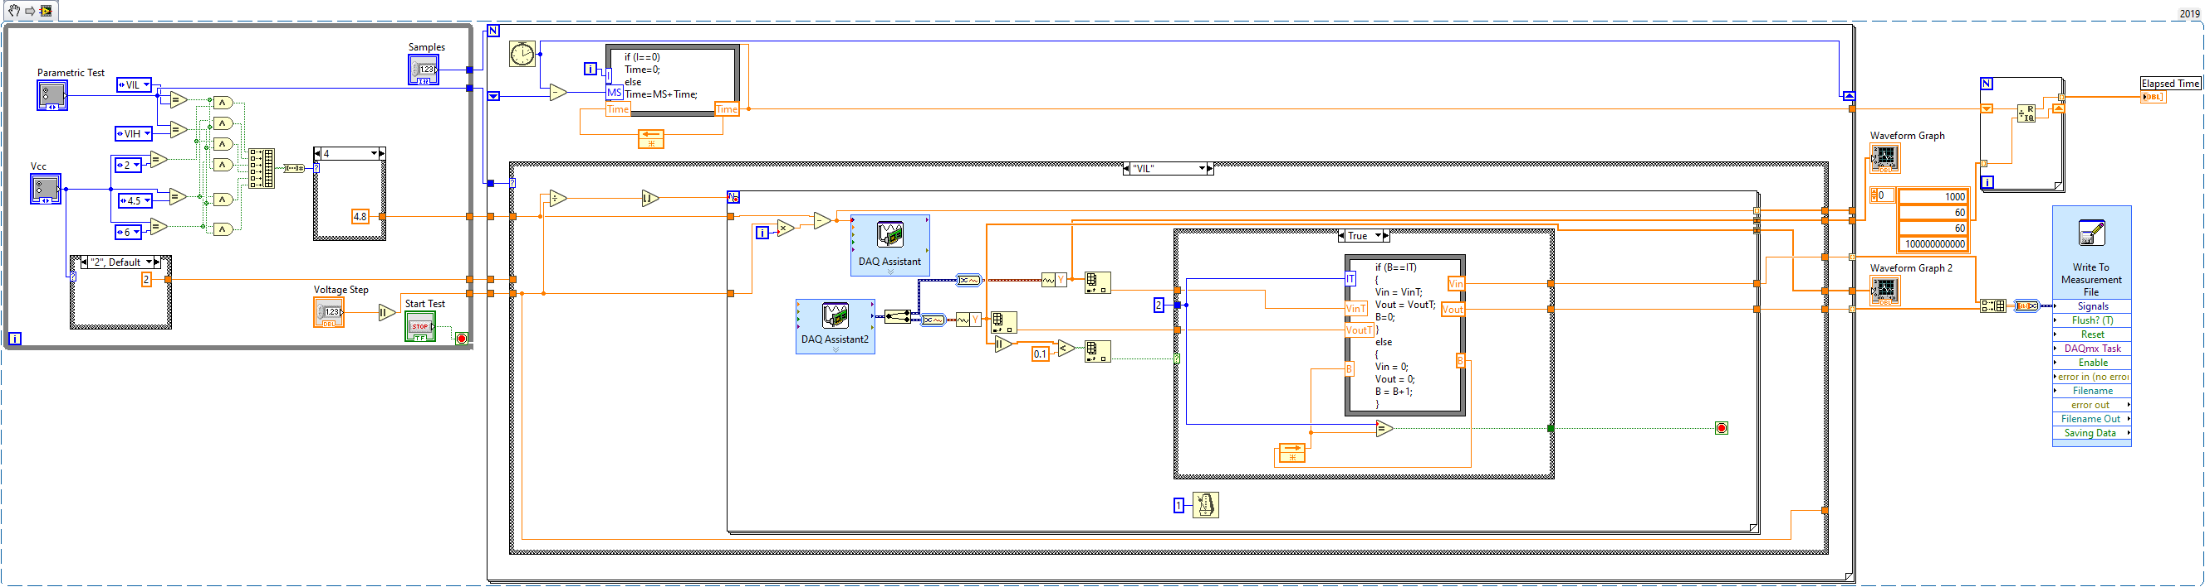
V_{IH} and V_{IL}
LabView Code:

Slide 36
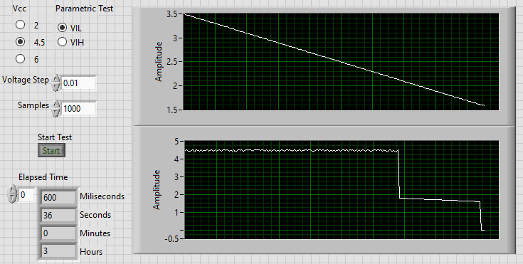
V_{IH} and V_{IL}
Results of V_{IL(max)} for V_{CC}= 4.5 V → V_{IL} = 1.59 V

Slide 37
V_{IH} and V_{IL}
Results of V_{IL(max)} for V_{CC}= 4.5 V → V_{IL} = 1.59 V
In the datasheet, it is stated that V_{IL(max)} = 1.35, but the test result is much higher than the specified maximum value. The same issue happened when I test measure V_{IH}:
→ Measured V_{IH} value is smaller than V_{IH(min)}.
This happens when V_{IL(max)} is measured. Measured V_{IL} value is greater than V_{IL(max)}.

Slide 38
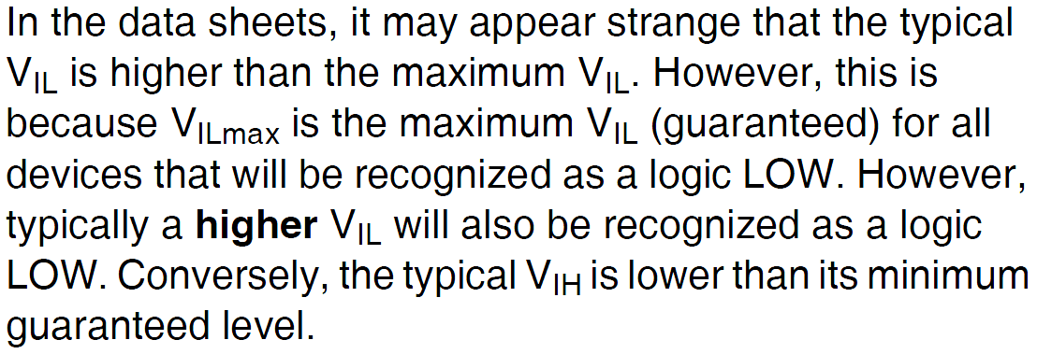
V_{IH} and V_{IL}
Why did it happen?

Slide 39
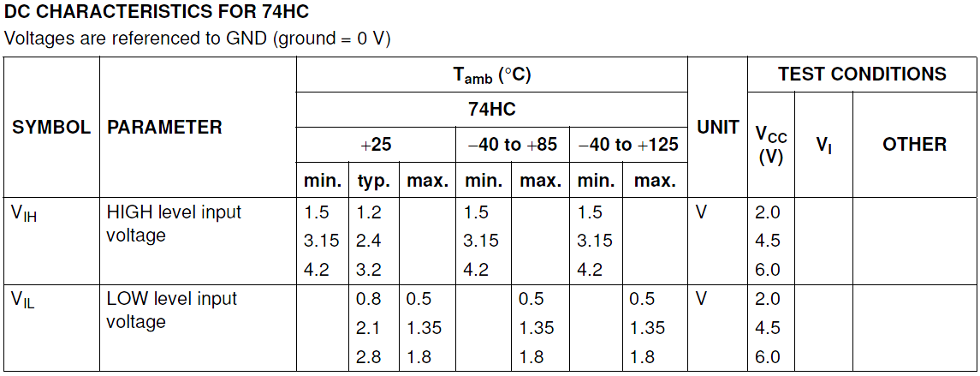
V_{IH} and V_{IL}
For example:

Slide 40
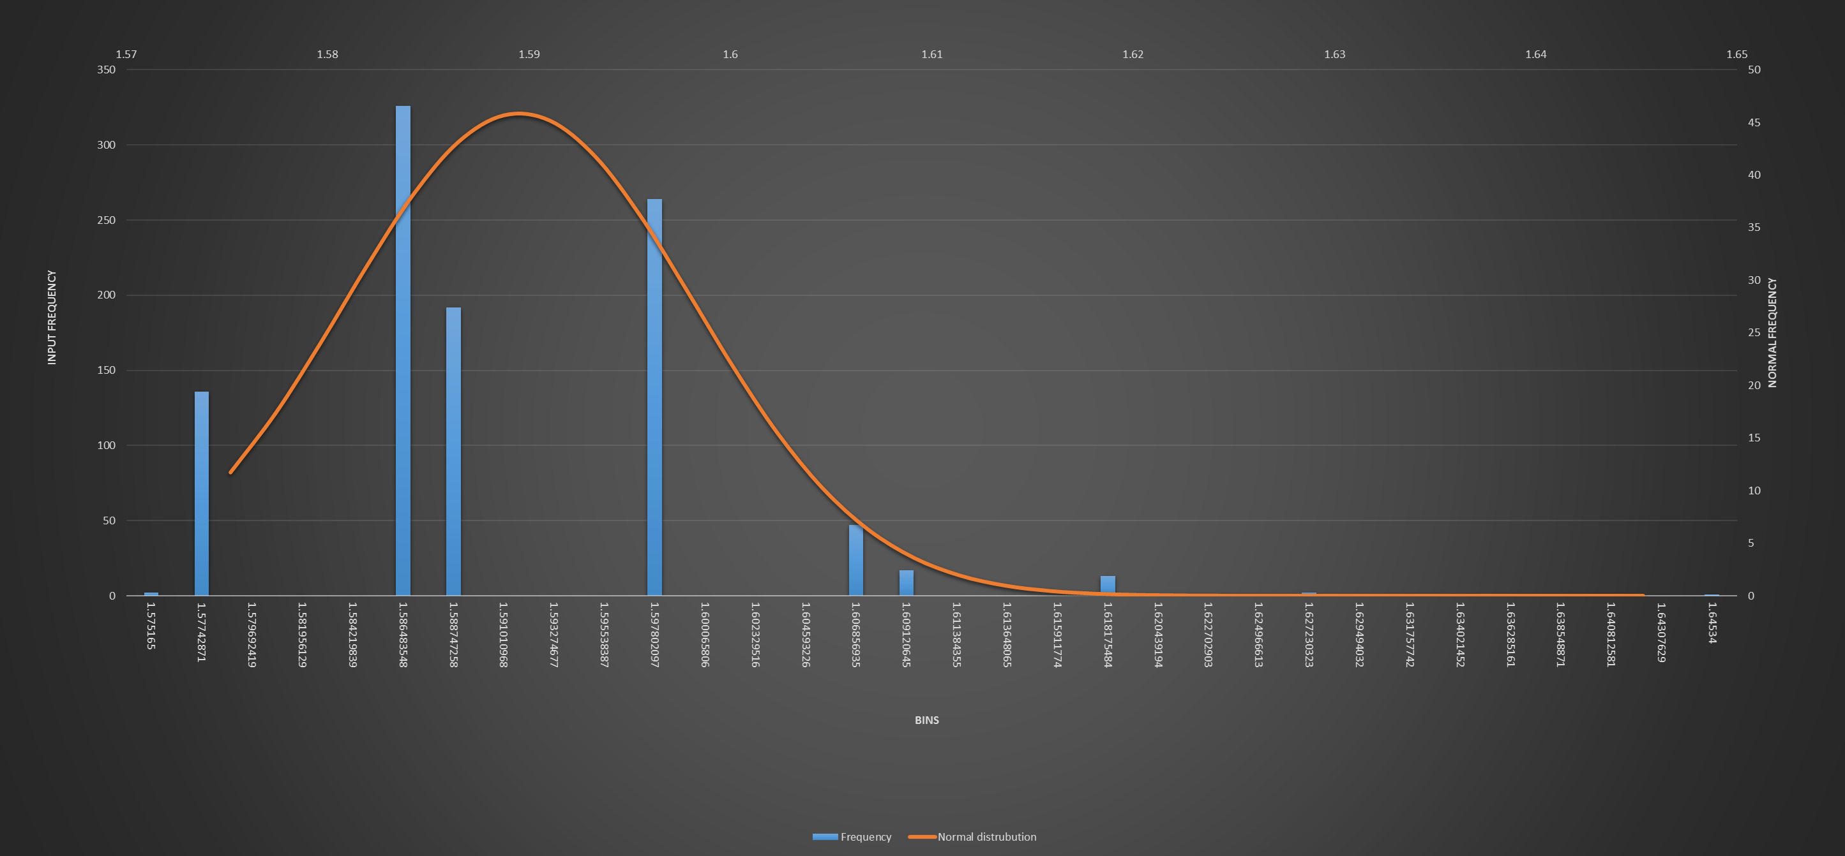
V_{IH} and V_{IL}
Histogram of V_{IL(max)} for V_{CC}= 4.5 V

Slide 41
V_{IH} and V_{IL}
Calculation of for V_{IL(max)} for V_{CC}= 4.5 V:
LSL = 0 V , USL = 2.1 V , μ = 1.59 , σ = 0.008692369
Process Capability = 0.052
Process Potential Index (C_{P}) = 40.3
Process Capability Index (C_{PK}) = 31.1

Slide 42
V_{IH} and V_{IL}
Final results:
 | VCC | USL | LSL | Target | μ | σ | CP | CPK
VIL | 2 | 0.8 | 0 | 0.5 | 0.71 | 0.236 | 5.6 | 2.6
 | 4.5 | 2.1 | 0 | 1.35 | 1.59 | 0.009 | 40 | 31
 | 6 | 2.8 | 0 | 1.8 | 1.89 | 0.013 | 35 | 32
VIH | 2 | 2 | 1.2 | 1.5 | 0.96 | 0.023 | 5.7 | -2
 | 4.5 | 4.5 | 2.4 | 3.15 | 2.43 | 0.022 | 15.9 | 5.2
 | 6 | 6 | 3.2 | 4.2 | 4.30 | 0.028 | 16.9 | 15.7

Slide 43
V_{OH} and V_{OL}
Test Conditions:
We need to apply V_{IL} to both inputs of the gate to measure V_{OL} and source a constant current to the gate output (as described in the datasheet).
We need to apply V_{IH} to both inputs of the gate to measure V_{OH} and sink a constant current from the gate output (as described in the datasheet).
Output prepare constant currents, we need current sources: one for sinking and one for sourcing.
A simple and accurate enough circuit is Wilson current source is used. They are designed, simulated and made for the tests.

Slide 44
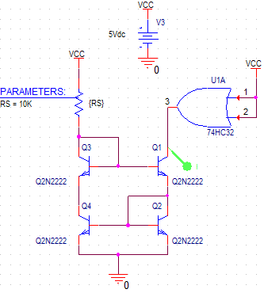
V_{OH} and V_{OL}
NPN transistors (2N2222A) are used to make a Wilson current source which is used to sink a constant current from the gate output when it is in its high state. This is used for measuring V_{OH}.

Slide 45
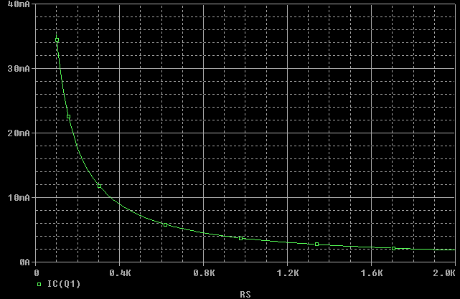
V_{OH} and V_{OL}

Slide 46
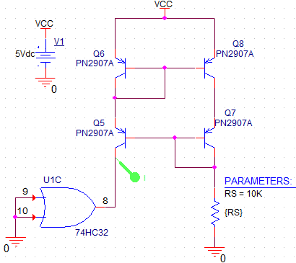
V_{OH} and V_{OL}
PNP transistors (PN2907A) are used to make a Wilson current source which is used to source a constant current to the gate output when it is in its low state. This is used for measuring V_{OL}.

Slide 47
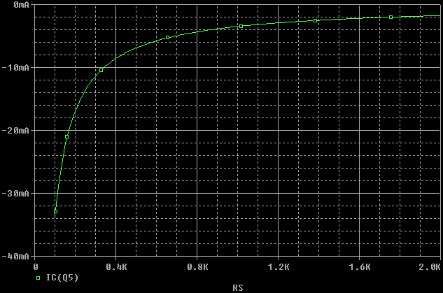
V_{OH} and V_{OL}

Slide 48
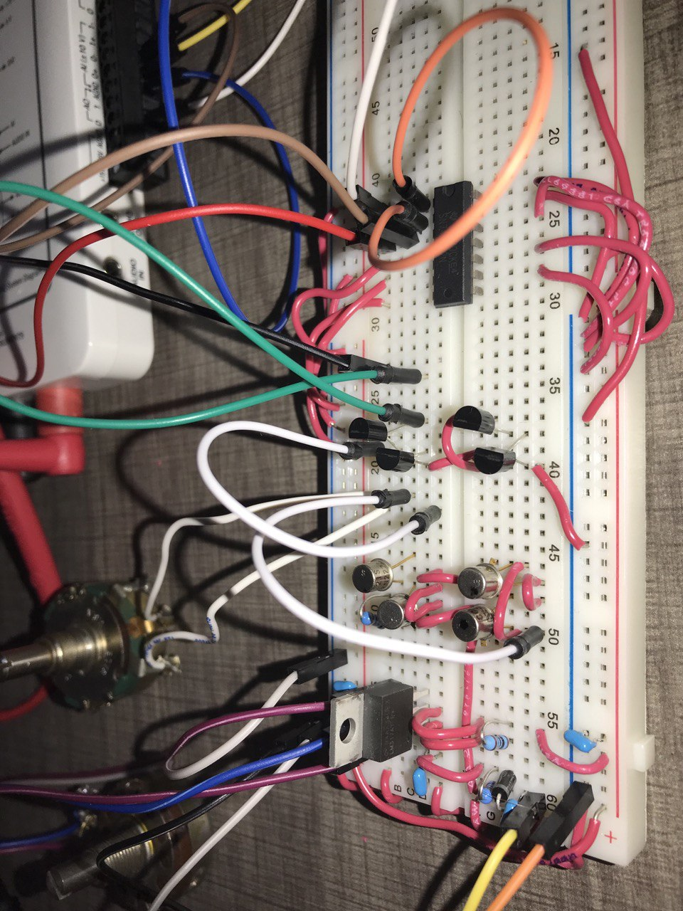
V_{OH} and V_{OL}

Slide 49
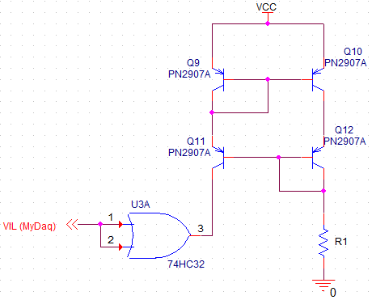
V_{OH} and V_{OL}
V_{OL} test setup: V_{IL} is set by MyDaq’s analog output to the value measured in the previous tests. The test is passed if the measured voltage is less than V_{OLmax} which is specified in the datasheet.

Slide 50
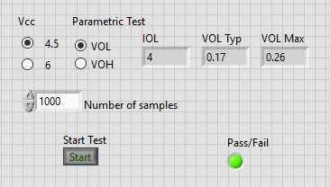


V_{OH} and V_{OL}

Slide 51
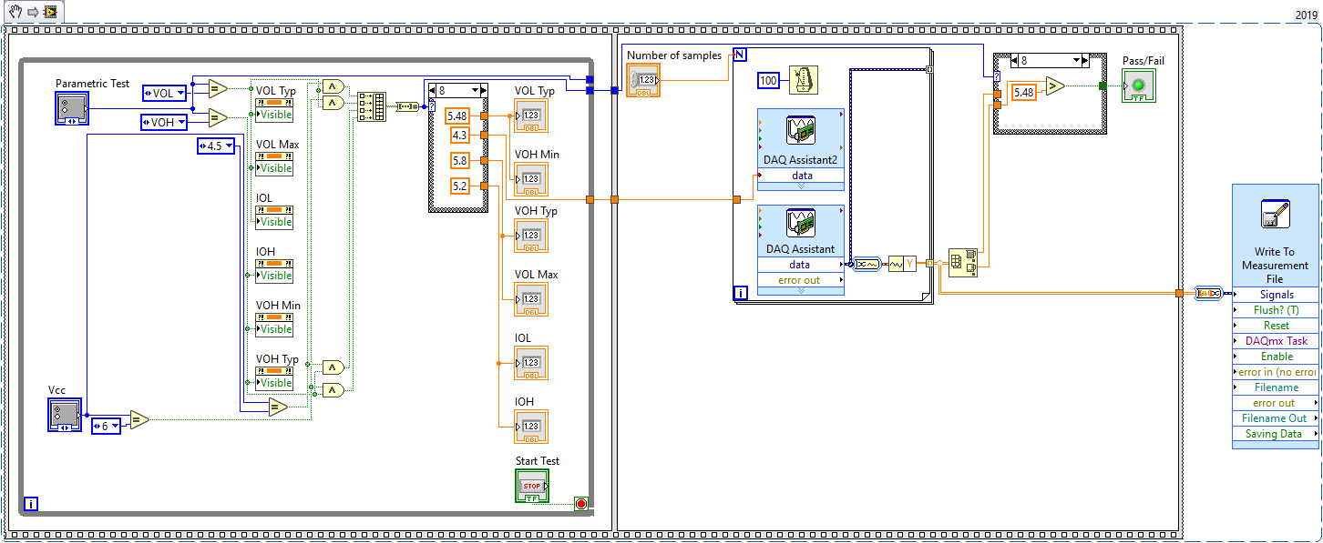
V_{OH} and V_{OL}

Slide 52
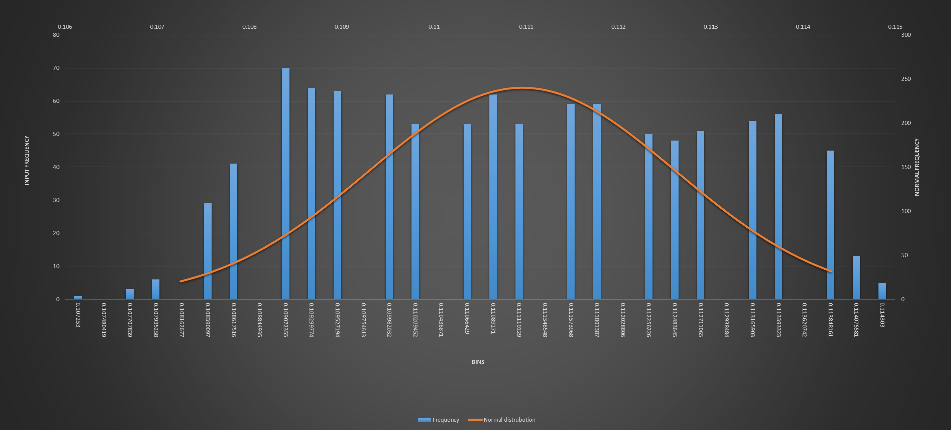
V_{OH} and V_{OL}
Histogram of V_{OL(max)} for V_{CC}= 4.5 V

Slide 53
V_{OH} and V_{OL}
V_{OL} and V_{OL} results:
 | V_{CC} | USL | LSL | Typ. Value | μ | σ | C_{P} | C_{PK} | Fail/Pass
V_{OL} | 4.5 | 0.26 | 0 | 0.17 | 0.11 | 0.002 | 26 | 14 | Pass
 | 6 | 0.26 | 0 | 0.15 | 0.12 | 0.002 | 28 | 21 | Pass
V_{OH} | 4.5 | 4.5 | 3.98 | 4.3 | 4.35 | 0.036 | 2.4 | 1.94 | Pass
 | 6 | 6 | 5.48 | 5.8 | 5.85 | 0.036 | 2.4 | 2 | Pass

Slide 54
References
“SNx4HC32 Quadruple 2-Input OR Gates”, Texas Instruments, April 2021, Link
“SN54/74HCT CMOS Logic Family Applications and Restrictions”, Texas Instruments, May 1996, Link
“Input and Output Characteristics of Digital Integrated Circuit”, Texas Instruments, May 1996, Link
“Designing With Logic”, Texas Instruments, June 1997, Link
“Understanding and Interpreting Standard-Logic Data Sheets”, Texas Instruments, June 2016, Link
“CMOS Logic IC HC/HCT (High Speed) Series Outline”, Toshiba Electronic Devices & Storage Corporation , March 2021, Link
“Family Specifications, HCMOS family characteristics”, Philips Semiconductors, March 1988, Link

